Slide 1
Problem statement(CR1)
Madras Madlads TL-Keerthivarman Prakash Table no-90

Slide 2
Our approach to the problem statement
Using specially engineered AI prompts and web scraping articles and sources, we can use Google’s Gemini AI(gemini flash 1.5) API to deliver summarized and concise responses to our required prompts.

Slide 3
Flowchart
Setup Gemini AI API
Extract latest news on competitors by webscraping
Extract Information from articles and sources.
Start
Provide the AI with required context to answer prompts
Initialize GUI
With news articles
Display response using the prompt in GUI
Stop

Slide 4
Usecases
This can be used to get appropriate information on croma and its competitors on various different fields
Can give strategic insights on what could be croma’s future plans for expansion of it’s buisness

Slide 5
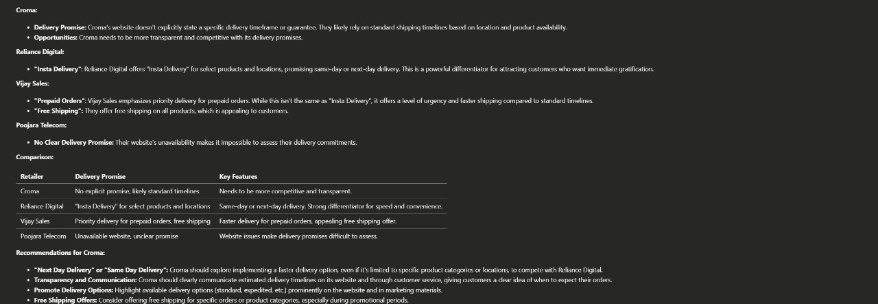
Images(Sample output)

Slide 6
Techstack and dependencies
Python language.
Requests and BeauitfulSoup-To extract data from articles and sources
Google gemini api-To provide a Gen AI response to prompts and to summarize new ariticles
Frontend using PyQt5 and related libraries
Dependencies- python compiler with requests module, BeautifulSoup module, PyQt5, google.generativeai

Slide 7
Thank you

